Slide 1

AI in Networking
Future of networking
Classification | INTERNAL

Slide 2
AGENDA :
What is artificial intelligence (AI) in networking?
What are the advantages of AI and ML in networking?
How does AI transform networking?
How important are AI and ML technologies in managing and monitoring today’s networks?
AI/ML and telemetry
AI-enabled networking use cases
AI/ML for tracking IoT endpoints
Machine learning for policy automation
Lifecycle Management:
Classification | INTERNAL

Slide 3
What is artificial intelligence (AI) in networking?
AI is software that performs a task on par with a human expert.
AI plays an increasingly critical role in taming complexity for growing IT networks.
Like -> Network optimization .
predictive maintenance ,
security . Etc
Classification | INTERNAL

Slide 4
What are the advantages of AI and ML in networking?
Automation :-
* Ai and ml can automate routing task such as
network monitoring
configuration management
troubleshooting
reducing manual effort and human error
Predictive maintenance :-
* Ml algorithm can historical network data to predict potential failures or performance issues ,
allowing for proactive maintenance and minimizing downtime
Classification | INTERNAL

Slide 5
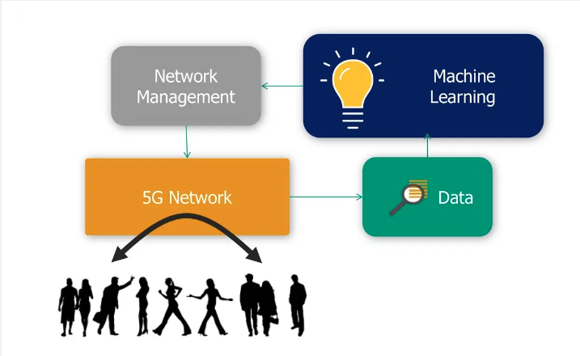
What are the advantages of AI and ML in networking?
Network optimization :-
* Ai can analyze network traffic patterns and dynamically adjust configuration to optimize
performance , resources utilization
Classification | INTERNAL

